Slide 1


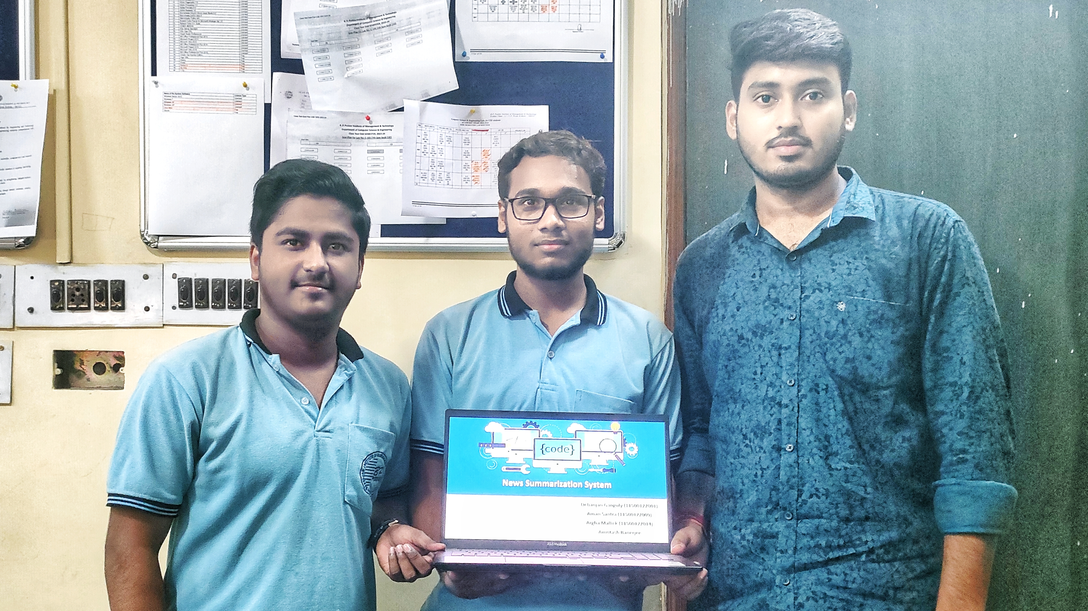
News Summarization System
Debanjan Ganguly
Aman Santra
Argha Mallick
Amritash Banerjee

Slide 2



Use Case Diagram
Request for News Articles
User
Initiates, provides input, receives output
Provides access to news articles
Google RSS news feed API
Process the news text with NLTK
Generate summaries
Handles user routes
System

